Slide 1

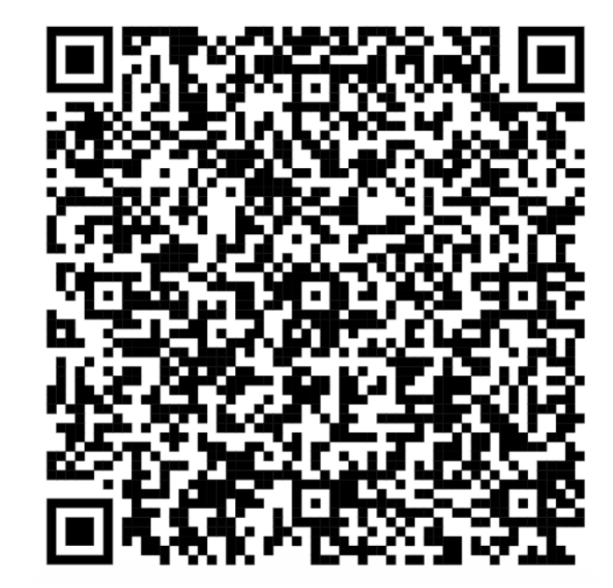
Satellite Building Workshop
Introduction

Slide 2
About Space Faculty Pte Ltd
Our expertise spans several key areas:
1. Satellite Development: From satellite building and launching to providing hands-on training in satellite development.
2. Scientific Advancement: Facilitating cutting-edge space experiments for the scientific community.
3. Workforce Development and Executive Programmes: Specialized Executive courses, training, workshops and hackathons to understand how space technologies can future proof your organization and your career
4. National-level Space and STEM 2.0 Roadmap Development: Executing impactful, roadmaps through training, "galaxy-class" competitions and hackathons with global experts to ignite youth interest in space and STEM fields.
HONORARY ADVISORS
Prof Lui Pao Chuen, Mr Atsushi Taira, Mrs Koh Soo Boon, Mr Seah Moon Ming, Dr Victoria Coleman
CEO
Ms Lynette Tan

Slide 3
Ang Eng Hian
Education:
  NUS BEng (EE)
  NUS MSc (EE)
  NUS MTech (SE)
Space Faculty
  Technical Consultant
DSO National Laboratories
  2007 to 2025
  Principal Engineer (Radar System Engineer, Satellite Payload System Engineer)
  RF system, Electronic, Software, FPGA, Signal Processing

Slide 4
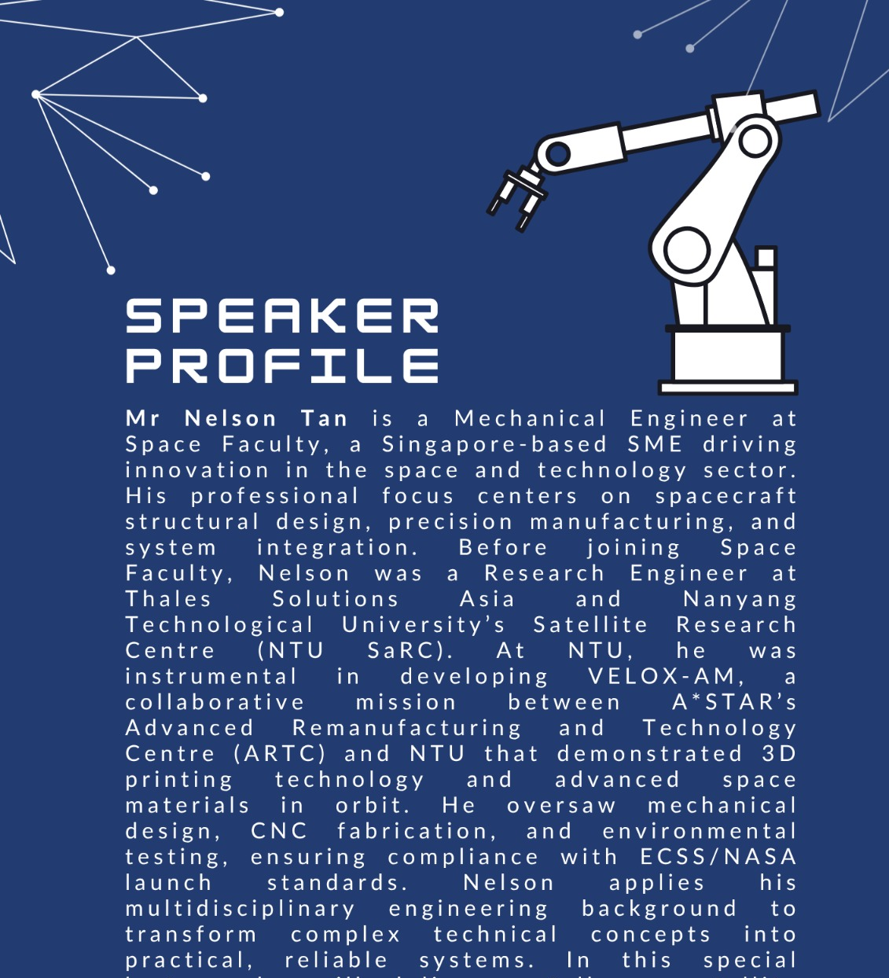
Nelson Tan
Education:
  NTU BEng (ME)
Space Faculty
  Satellite Engineer

Slide 5
Lam Lap
Education:
  MSc in Electrical Engineering (UIUC, USA)
Space Faculty
  Technical Director
DSO National Laboratories
  2003 to 2024
  Programme Director

Slide 6
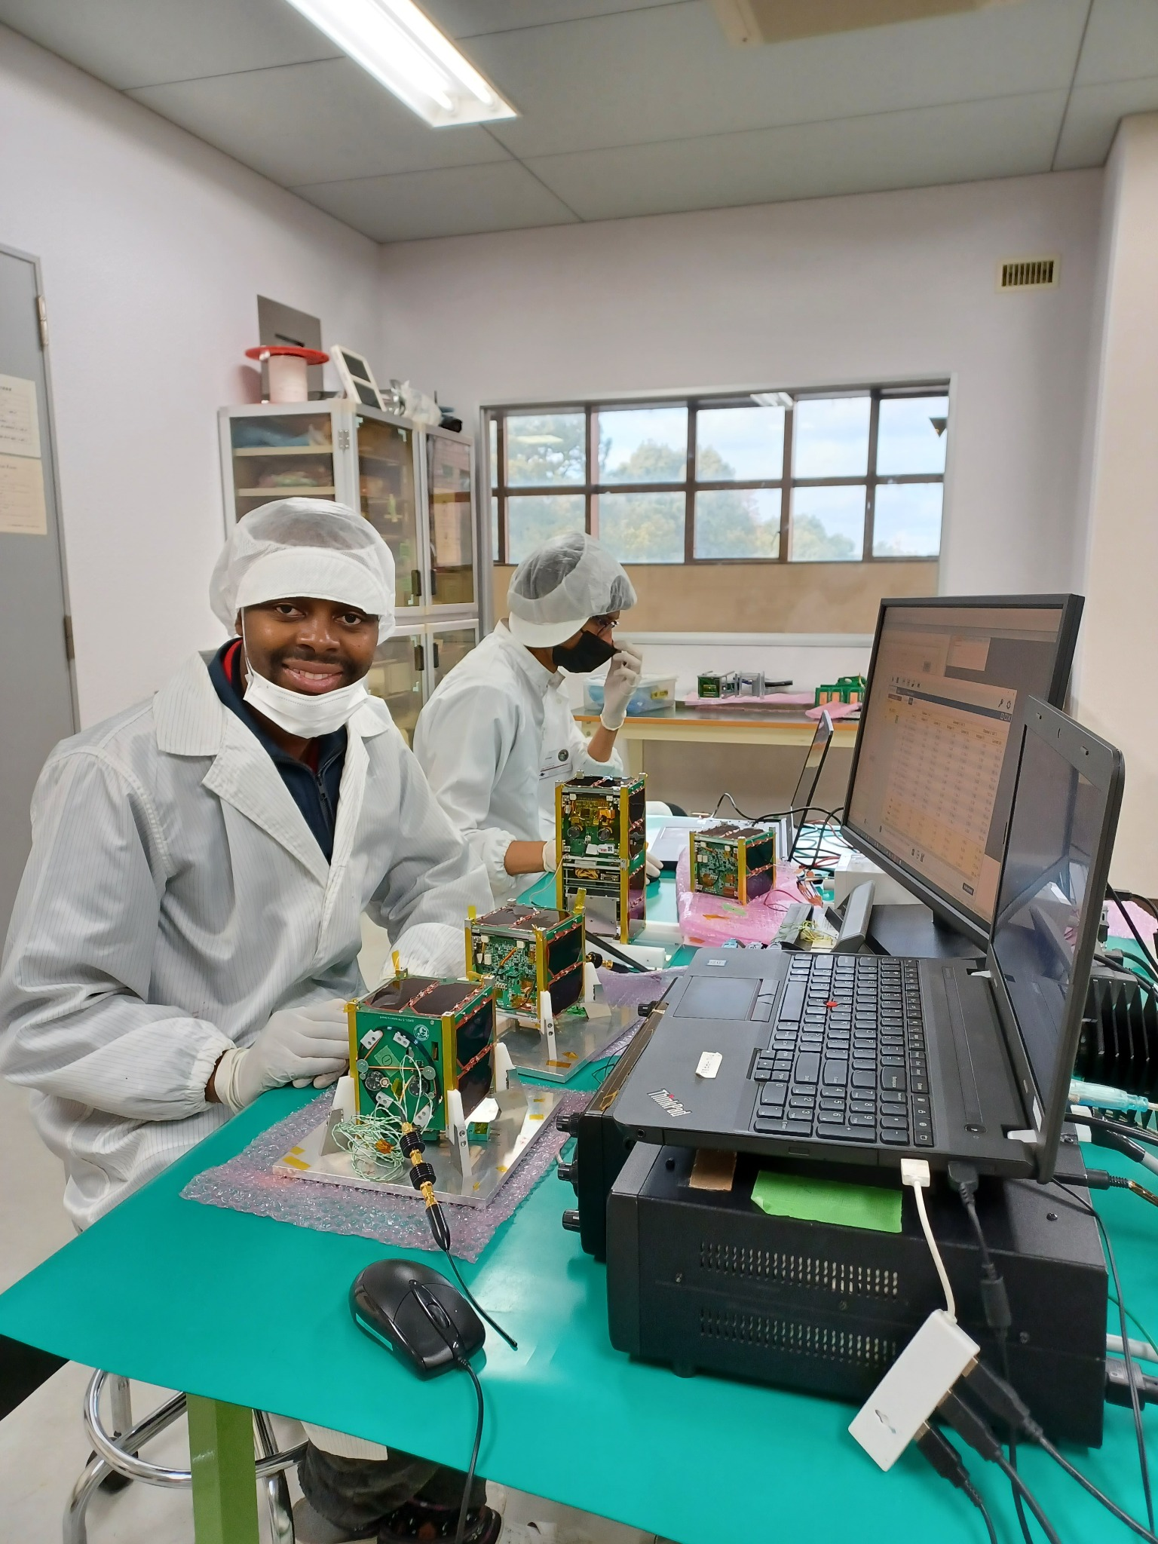
KEYNOTE TRAINER / SPACECRAFT DESIGN WORKSHOP
Dr Ramson Munyaradzi Nyamukondiwa
Incoming Head of Space Activities | Space Faculty
Space systems engineer and educator bridging spacecraft design, hands-on engineering, integration, testing and mission operations.
LEADERSHIP & ENGINEERING
TRAINING & CERTIFICATIONS
Former Faculty Lead & Assistant Professor
Space Engineering, International Space University (ISU)
Former Acting Director, Administration & Finance; Chief / Principal / Senior Systems Engineer, ZINGSA
CanSat / CubeSat Trainer — UNISEC Global, Japan
Space Engineering Teaching Methods — AOTS, Japan
Certified Satellite Operator — USFCC
Amateur Radio: Extra Class licence
ACADEMIC BACKGROUND
PhD | Electrical & Space Systems Engineering
Kyushu Institute of Technology, Japan
MEng | Electronics & Information Engineering
Chonbuk National University, South Korea
BSc | Electronics Engineering
University of Tlemcen, Algeria
SPACECRAFT DESIGN • FROM CONCEPT & SUBSYSTEMS TO INTEGRATION, TESTING AND OPERATIONS

Slide 7
Rohini Parthasarathy
Education:
  Master of Space Studies, International Space University
  B.E. (EEE), Chennai Institute of Technology
Experience:
  Space Faculty Pte Ltd : 2026 - present

Slide 8
Dr NARAYANASWAMY (Nagarajan) NAGARAJAN
Education:
  PhD Aerospace, Indian Institute of Science
Experience:
  Aerospace Engineer and Consultant
  2010 – 2016: ST Engineering (Satellite Systems). Satellites: TeLEOS-1, TeLEOS-2
  1999 – 2008: NTU Asst Professor; Satellite XSAT team
  1977 – 1997: ISRO Satellite Centre

Slide 9
Agenda
Day 3 | Thursday 15 October 2026
Time | Duration | Session
09:00 – 09:30 | 30 min | Morning tea and coffee with light refreshments
09:30 – 10:00 | 30 min | Introduction and mission brief
10:00 – 11:00 | 1 h | Lecture 1: From mission model to hardware
11:00 – 12:00 | 1 h | Build Session 1: Structure, avionics and C&DH bring-up
12:00 – 13:00 | 1 h | Lunch
13:00 – 13:45 | 45 min | Build Session 1 (continued)
13:45 – 14:45 | 1 h | Lecture 2: Power and thermal
14:45 – 15:15 | 30 min | Afternoon tea break
15:15 – 17:00 | 1 h 45 min | Build Session 2: Power integration and telemetry

Slide 10
Agenda
Time | Duration | Session
09:00 – 09:30 | 30 min | Morning tea and coffee with light refreshments
09:30 – 10:15 | 45 min | Lecture 3: Pointing and attitude control
10:15 – 11:15 | 1 h | Build Session 3: ADCS configuration and test
11:15 – 12:00 | 45 min | Lecture 4: Payload and the link to the ground
12:00 – 12:45 | 45 min | Build Session 4: Payload integration and downlink check
12:45 – 13:45 | 1 h | Lunch
13:45 – 14:45 | 1 h | Build Session 4 (continued)
14:45 – 16:00 | 1 h 15 min | Design reviews (short lecture); Mission review session
16:00 – 16:30 | 30 min | Certificate presentation (with refreshments)
16:30 onwards | – | Networking reception (with refreshments)

Slide 11
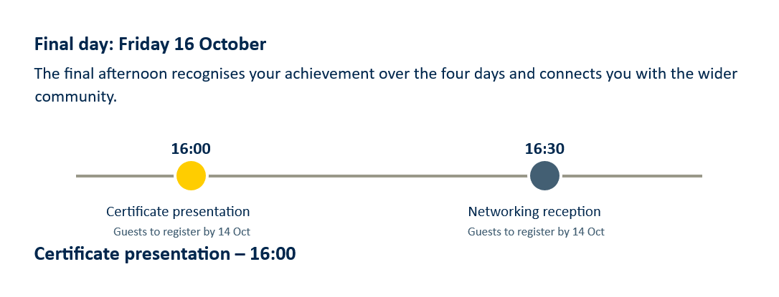
Agenda

Slide 12

Agenda
Networking reception – 16:30
Following the certificate presentation, you and your guest are invited to join the networking reception with other industry guests. Your guest is welcome to attend the reception even if they do not attend the presentation.
Guest registration
Participants do not need to register. Guests attending the certificate presentation, the networking reception, or both must register by Wednesday 14 October 2026. Please share this link with your guest:
luma.com/tz2solmo

Slide 13
Course Materials
https://github.com/learnspacefaculty-bit/Spacecraft-design-course

Slide 14
Notes
Handling of soldered cables, solar panels
Explain the circuit of RBF
Explain the need to be careful in flashing correct code
No sticker/tape on solar panels
Follow the Arduino installation instruction correctly
Follow the assembly slides correctly

Slide 15
Misc
75% attendance for Certificate of Completion
Final Mission Exercise Report (to submit within 2 weeks)
  Email to : learn@spacefaculty.asia
Apply for participation in Satellite Building Project:
  Email with resume: learn@spacefaculty.asia
  State the period of availability

Slide 16
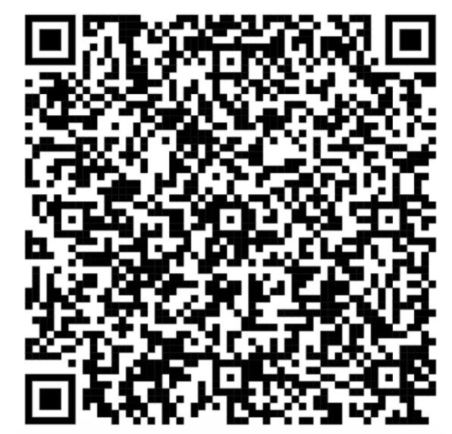
Workshop Survey

Slide 17
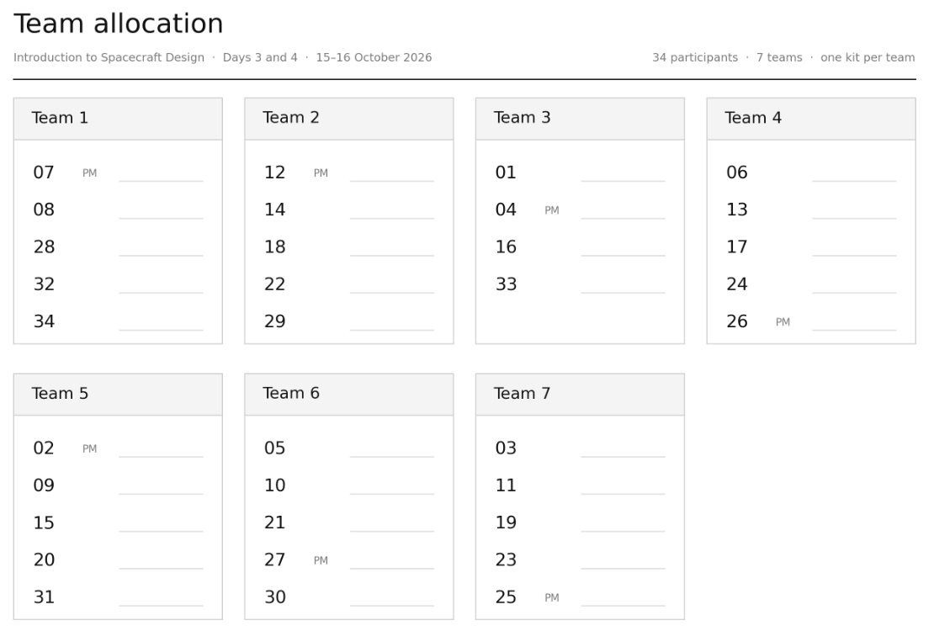

Slide 18
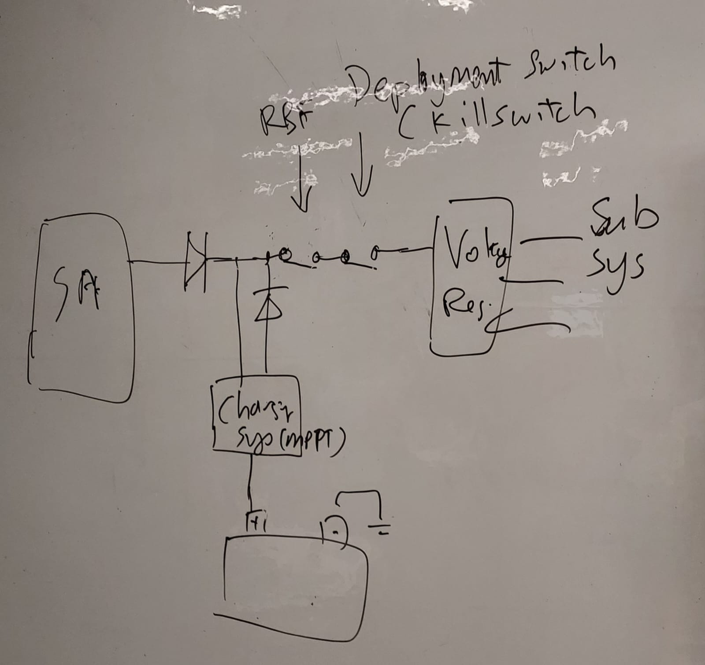
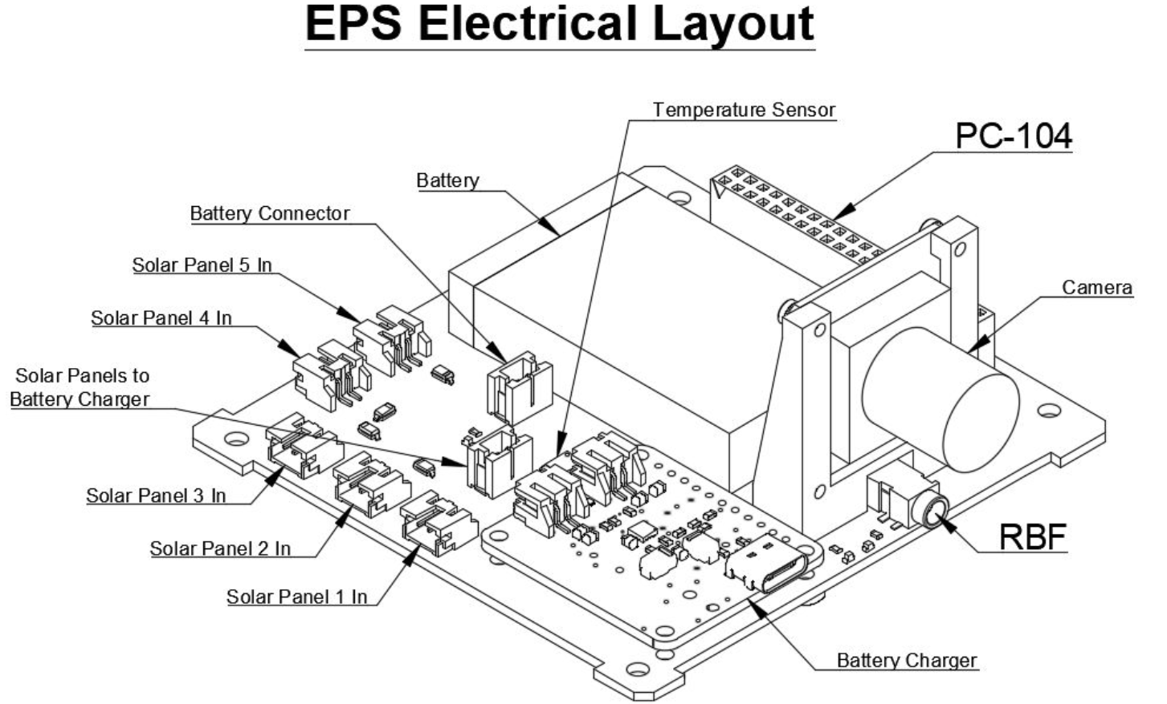
EPS Architecture and RBF

Slide 19

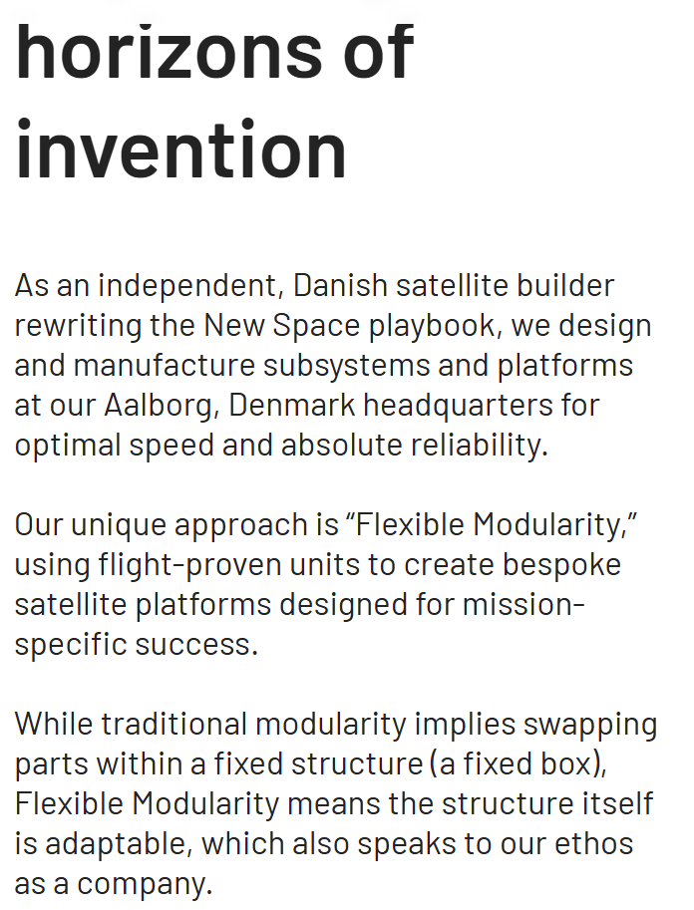
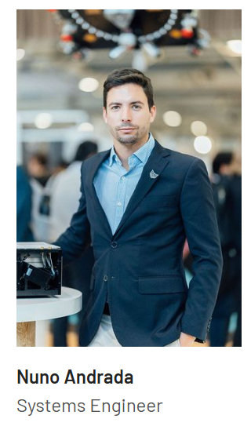
Space Inventor: Nuno Andrada

